Slide 1
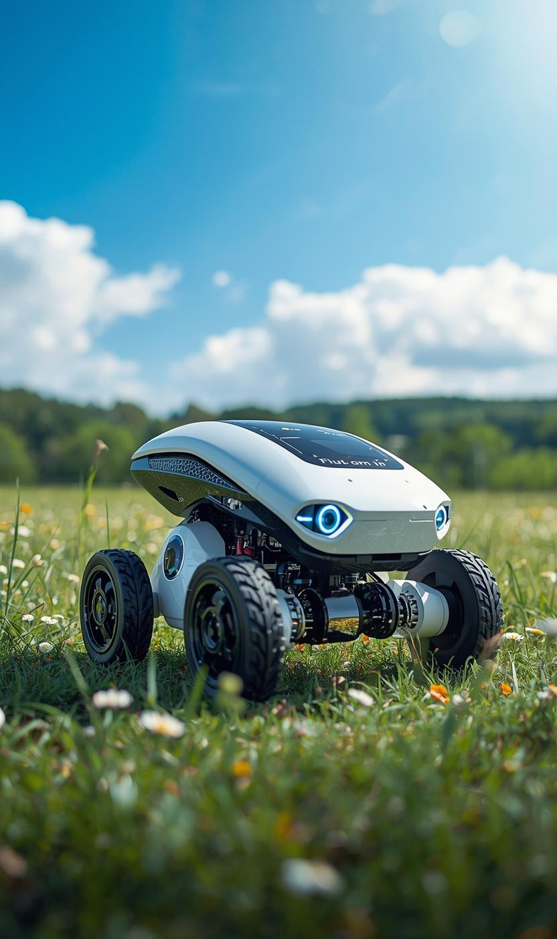

Build Your First Autonomous Robot
PRESENTED BY
MD. RASEL ISLAM
Convenor,
DIU Robotics Club

Slide 2
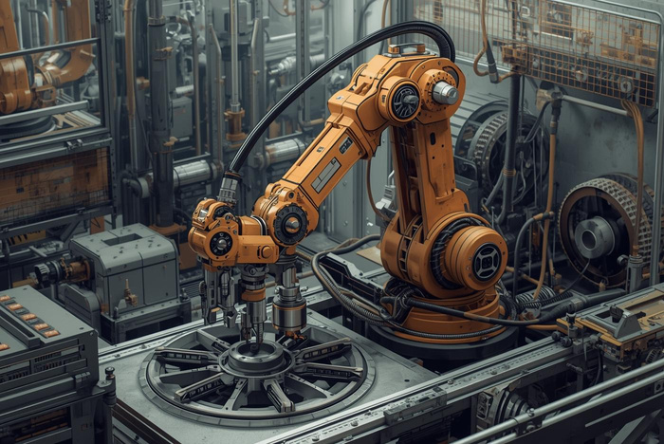
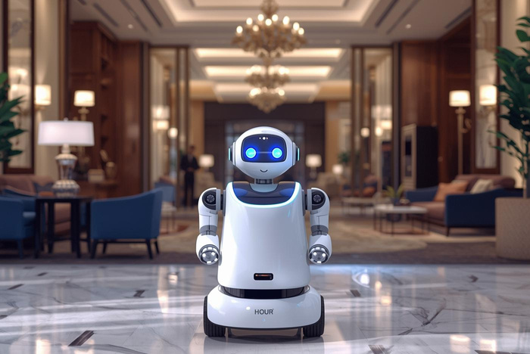
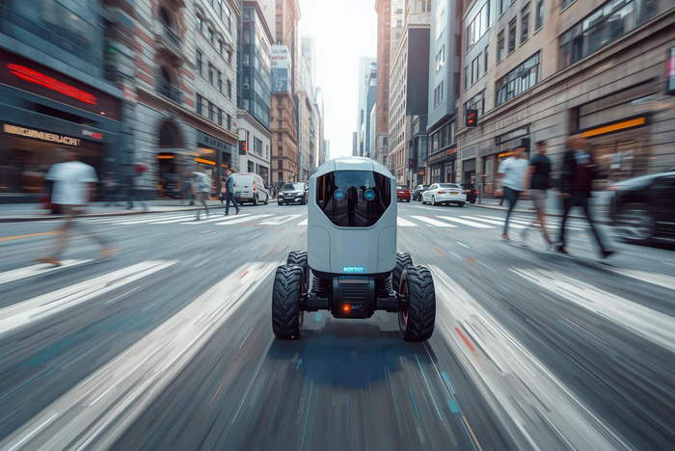
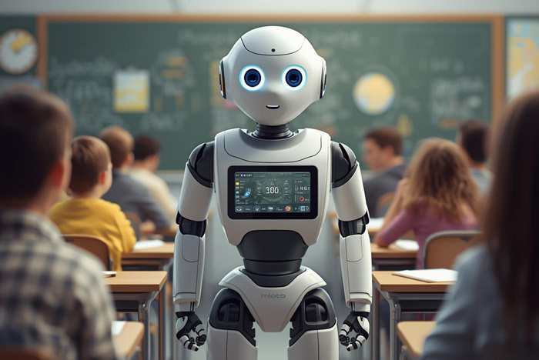
Types of Robots in Robotics
INDUSTRIAL
SERVICE
Used for automated manufacturing processes
Assists in customer service environments
MOBILE
HUMANOID
Navigates and interacts with environments
Mimics human appearance and behavior

Slide 3
Robotics History Timeline
FIRST INDUSTRIAL ROBOT
EARLY AUTOMATONS
EMERGENCE OF AI
PERSONAL ROBOTS
AUTONOMOUS VEHICLES
Early 20th century mechanical devices performed tasks.
1956, Unimate becomes the first industrial robot used.
1950s, AI research begins, enabling intelligent behavior.
2000s, robots designed for household tasks emerge widely.
2010s, development in self-driving cars and drones advances.

Slide 4
Workshop Overview and Learning Objectives
WHAT PARTICIPANTS WILL LEARN
Participants will explore the fundamentals of autonomous robotics. Topics include:
Understanding autonomy and its significance
Overview of autonomous vehicles
Insights into obstacle avoiding robots
Required components for building
Step-by-step building process

Slide 5
Workshop Goals: Build Your Robot
CREATE AUTONOMOUS SOLUTIONS
Participants will gain hands-on experience, enabling them to construct a functional autonomous obstacle avoiding robot using essential components and techniques.

Slide 6
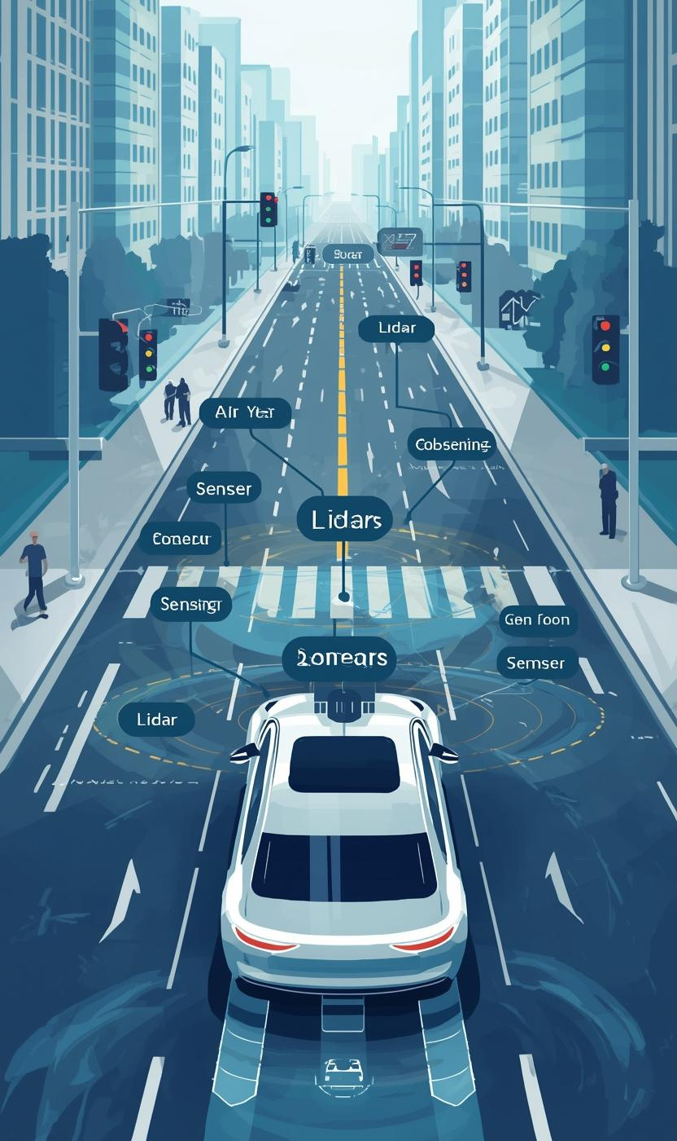
Understanding Autonomy in Robotics Systems
CORE CONCEPTS EXPLAINED
Autonomy in robotics refers to the ability to perform tasks without human intervention, enabling machines to operate independently in various environments.

Slide 7
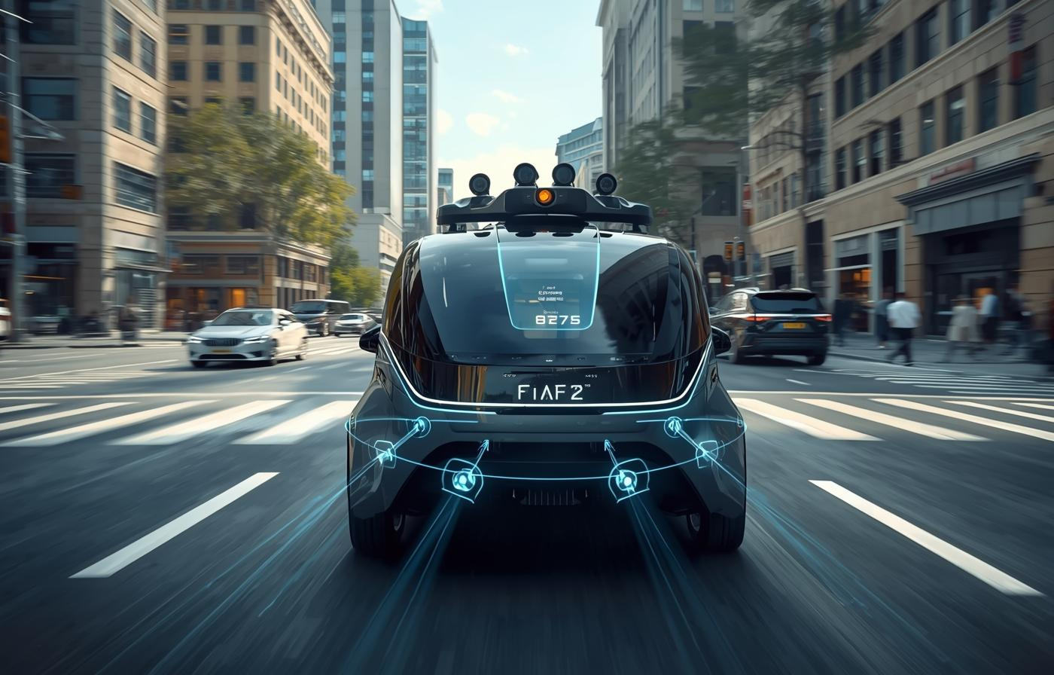
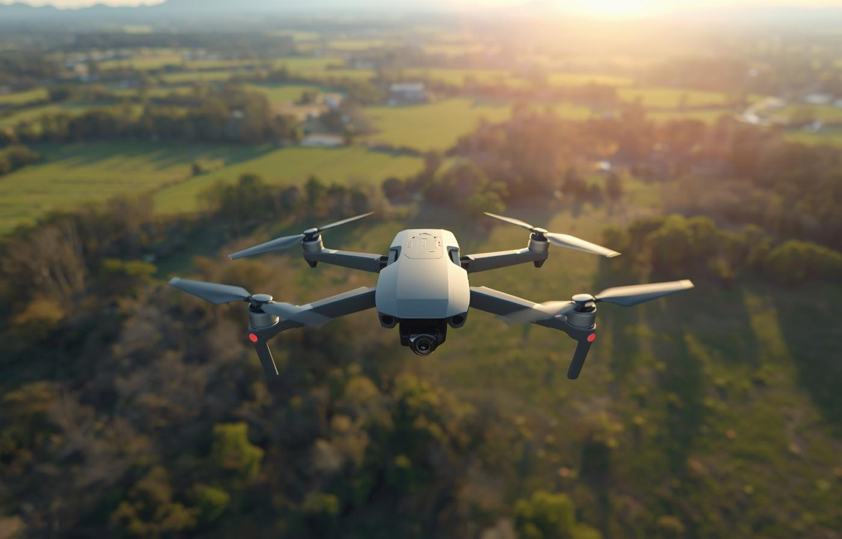
Examples of Autonomous Systems in Robotics

Slide 8
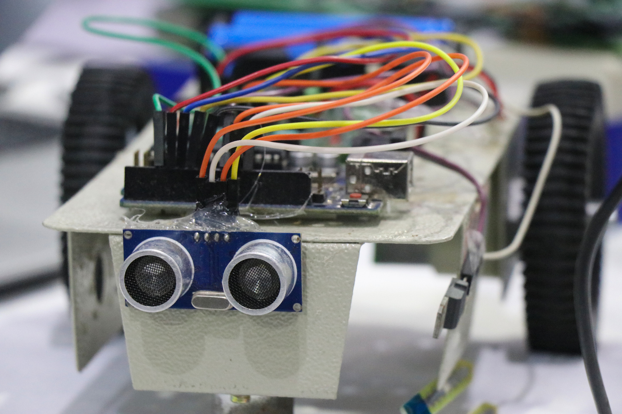
Key Technologies
ENABLING ROBOTIC AUTONOMY
Arduino Uno
L293D motor driver
Sonar sensor
Servo motor
DC mootor and wheel, body chasis
Battery and case
Jumper wire

Slide 9
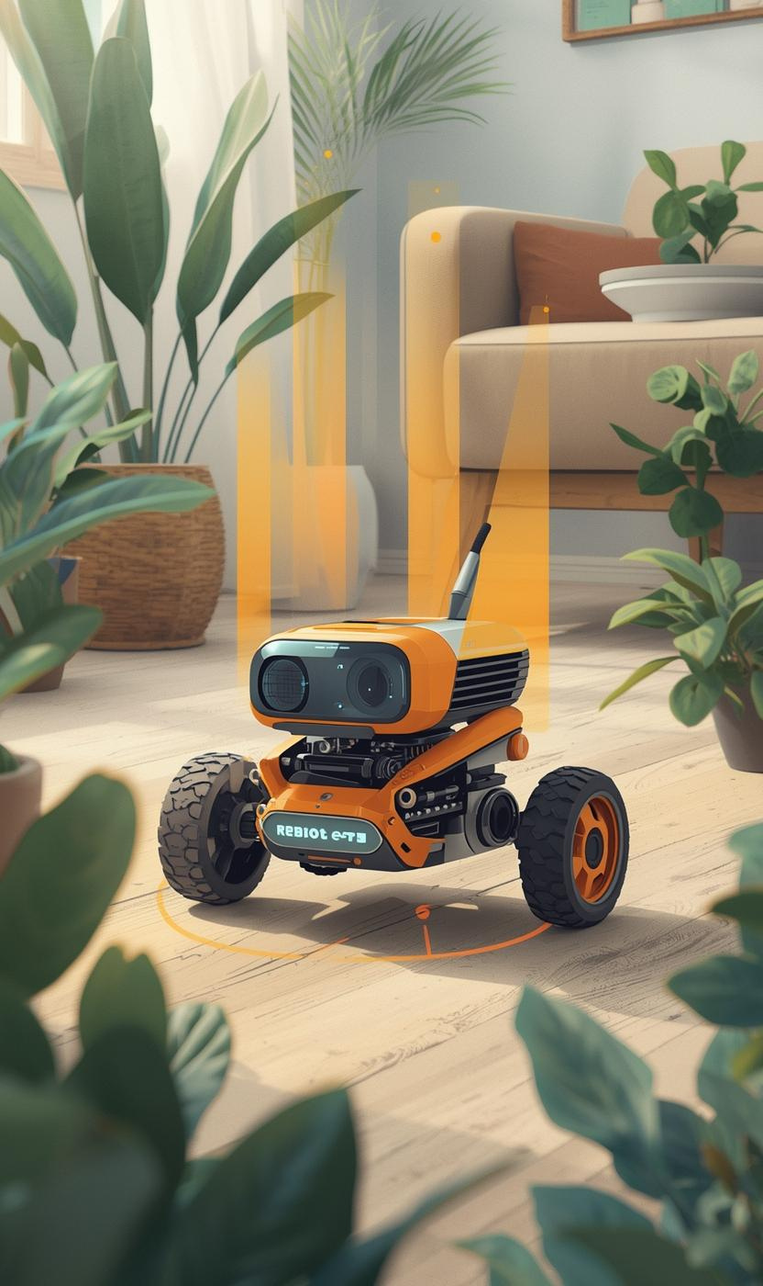
Obstacle Avoiding Robots: Key Concepts and Components
UNDERSTANDING THE ESSENTIALS
Obstacle avoiding robots use sensors and control systems to navigate environments autonomously, preventing collisions and performing various operational tasks efficiently.

Slide 10
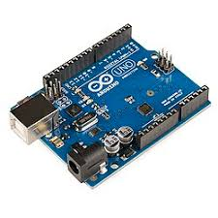
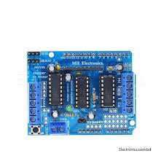
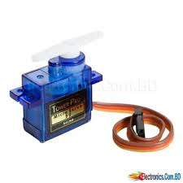
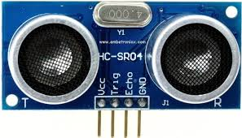
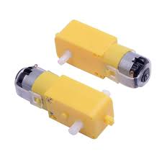
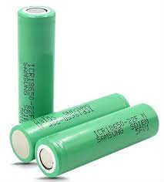

Slide 11

How Obstacle Avoidance Works
PROCESSING
ACTING
SENSING
The microcontroller processes the sensor data using algorithms to determine the best course of action for obstacle avoidance.
Motors receive commands from the processor, adjusting the robot's movement based on the processed sensor information to navigate effectively.
Sensors detect obstacles by emitting signals and measuring their return, providing essential data for the robot's navigation decisions.

Slide 12
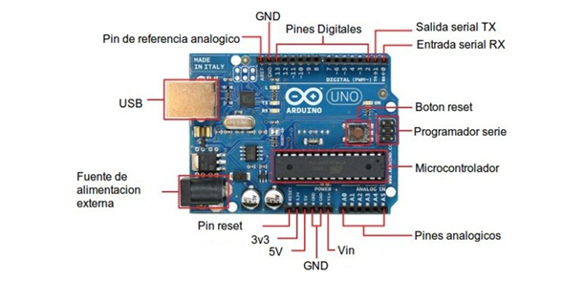

Slide 13
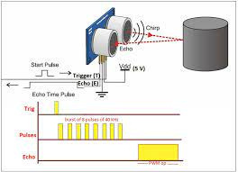
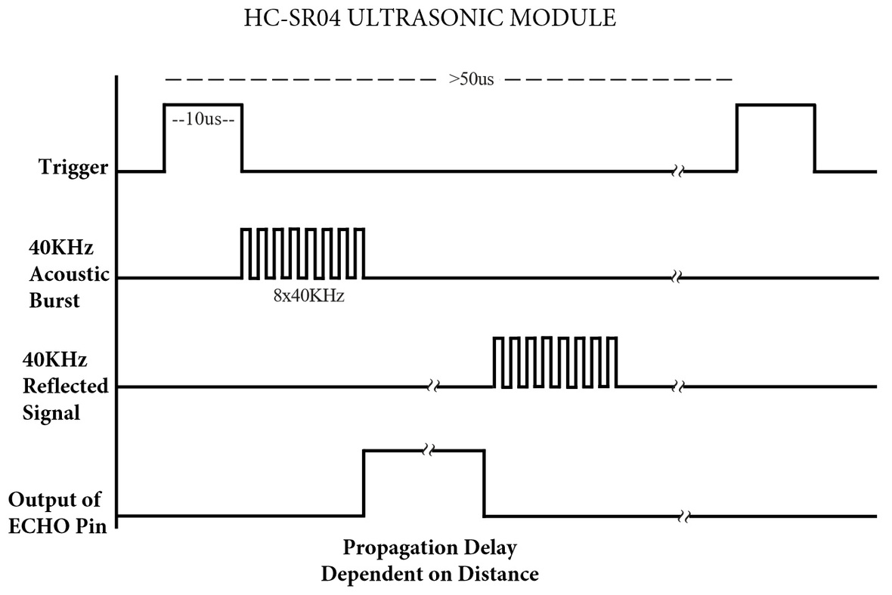

Slide 14
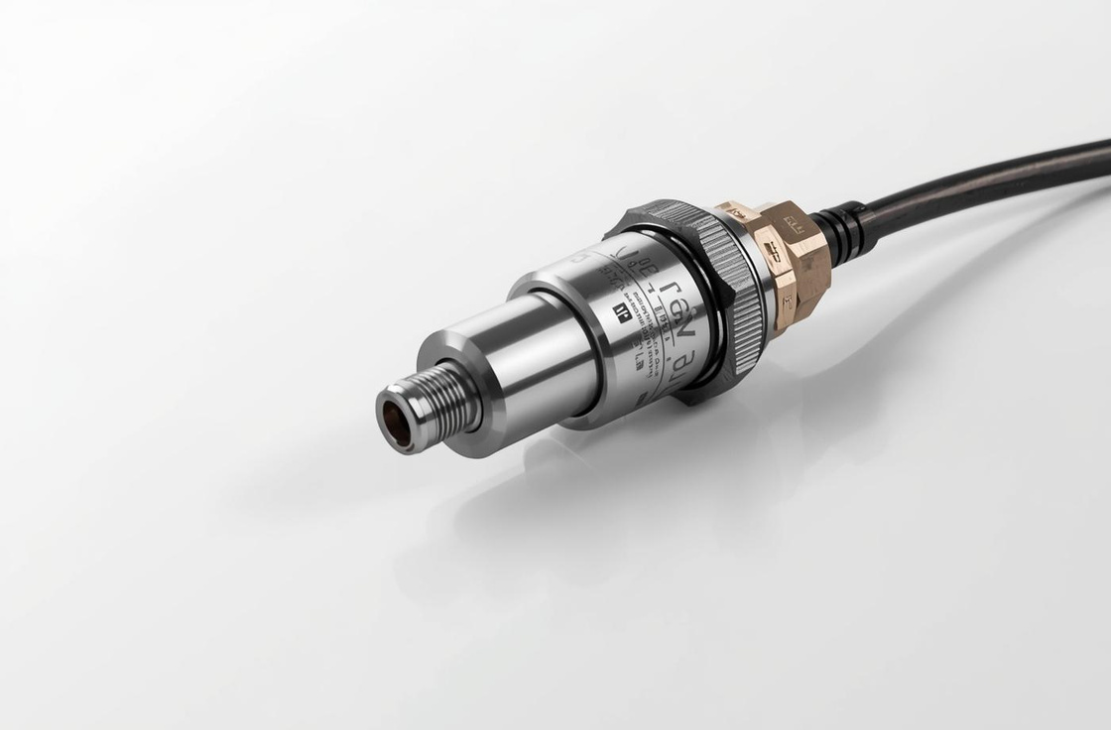
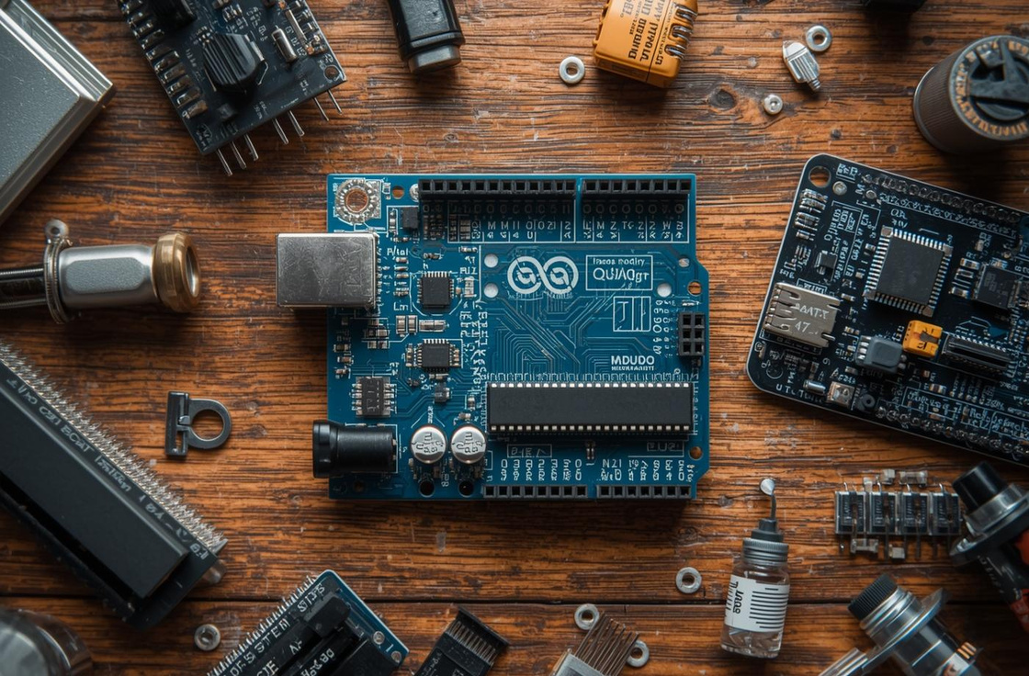
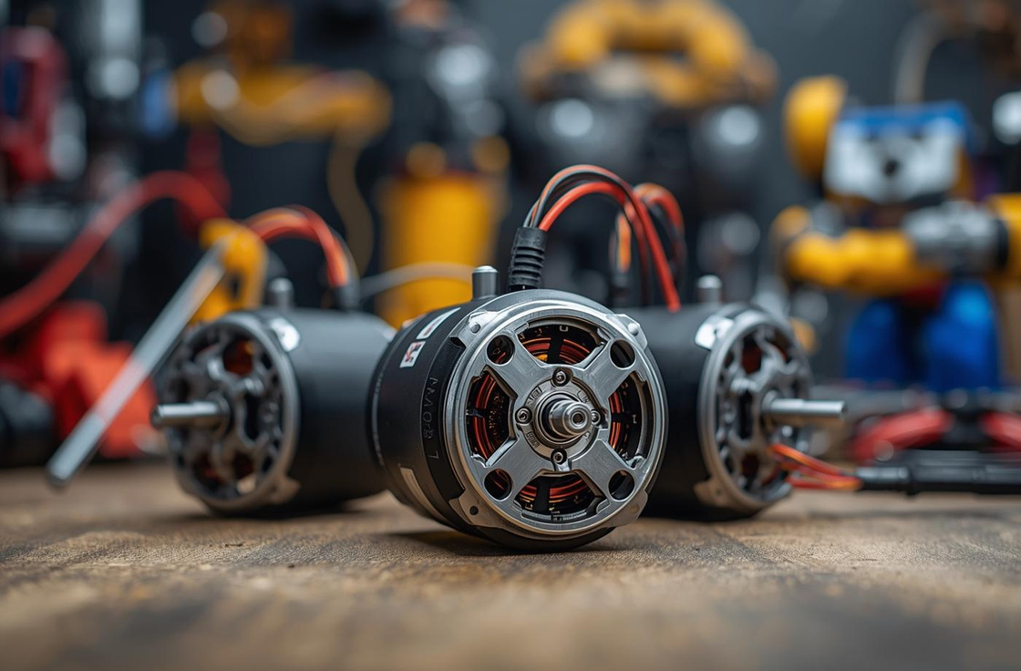
Required Components for Building Your Robot
SENSORS
MICROCONTROLLER
MOTORS
Essential for detecting obstacles and surroundings.
Acts as the brain, processing inputs and outputs.
Enable movement through mechanical action and control.

Slide 15
Component Interaction in the Robot System
HOW COMPONENTS WORK TOGETHER
The robot's sensing, processing, and acting components interact seamlessly to enable effective obstacle avoidance and ensure smooth operation in real-world scenarios.

Slide 16
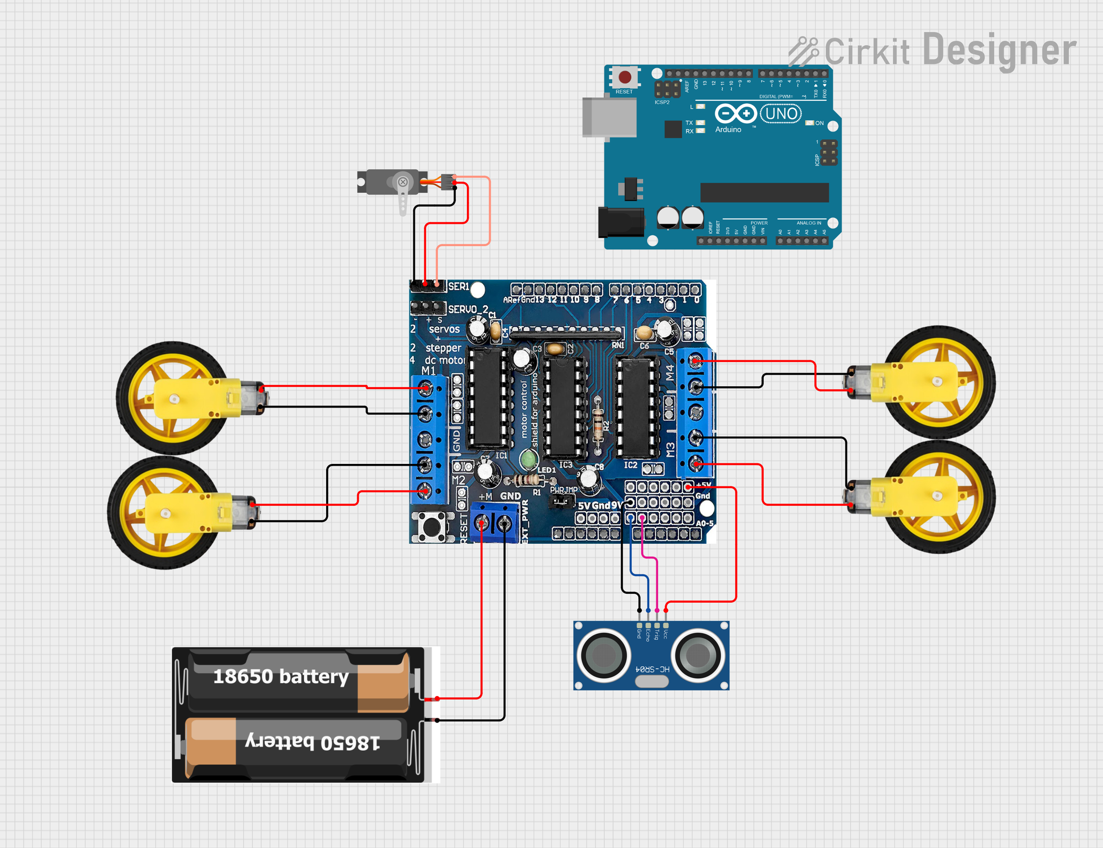
CIRCUIT DIAGRAM

Slide 17
Build Process Timeline
ASSEMBLE CHASSIS
CONNECT SENSORS
UPLOAD CODE
Construct base and attach the motors securely.
Wire sensors to the microcontroller correctly.
Transfer control program to the robot system.

Slide 18
Key Learnings and Next Steps
EXPLORE MORE ROBOTICS
Understand the fundamentals of robotics and autonomy
Familiarize with obstacle avoiding robot components
Gain hands-on experience in building a robot
Experiment with robotics projects for deeper learning
Stay engaged with robotics communities and resources

Slide 19



Any Question?

Slide 20


